Slide 1
Basic R – Workshop 0

Slide 2
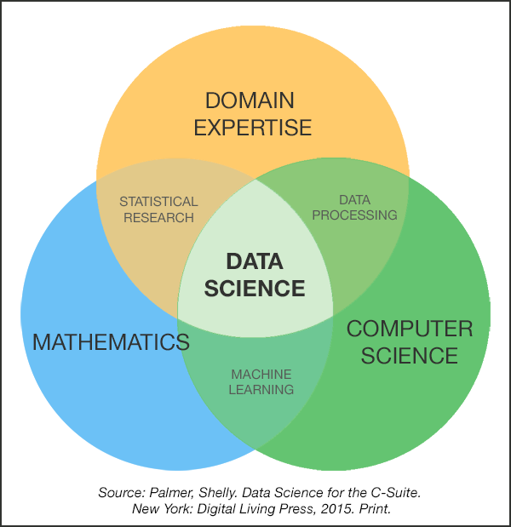
1. a. What is Data Science
github.com/bulutyazilim/awesome-datascience
Data Science and analytics job market by PWC

Slide 3

1. b. Why to use R
Open source
Simple syntax
Living community
Still in development
No. 1 Statistical language in TIOBE index
Multiparadigm

Slide 4

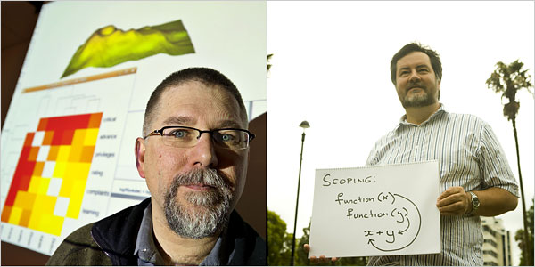
1. c. Short history of R
S

Slide 5


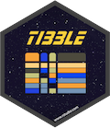
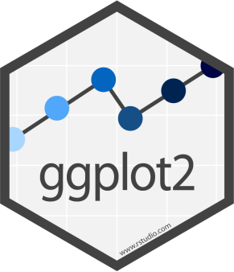
1. d. Community and current development

Slide 6
1. e. R features
R for beginners
Conditionals, loops, user defined recursive functions, input, output facilities
Data handling, storage facility
Vectors (arrays, lists, matrices)
Tools for data analysis
Graphical facilities

Slide 7
2. a.-e. installation, PAPA02, create .R file, run from Bash, run from interactive shell
print(“Hello world”)
Rscript //Rscript.exe – batch mode
R //R.exe – int. shell
source(“Script1.R)

Slide 8
2. g. i. git
rogerdudler.github.io/git-guide/

